Slide 1
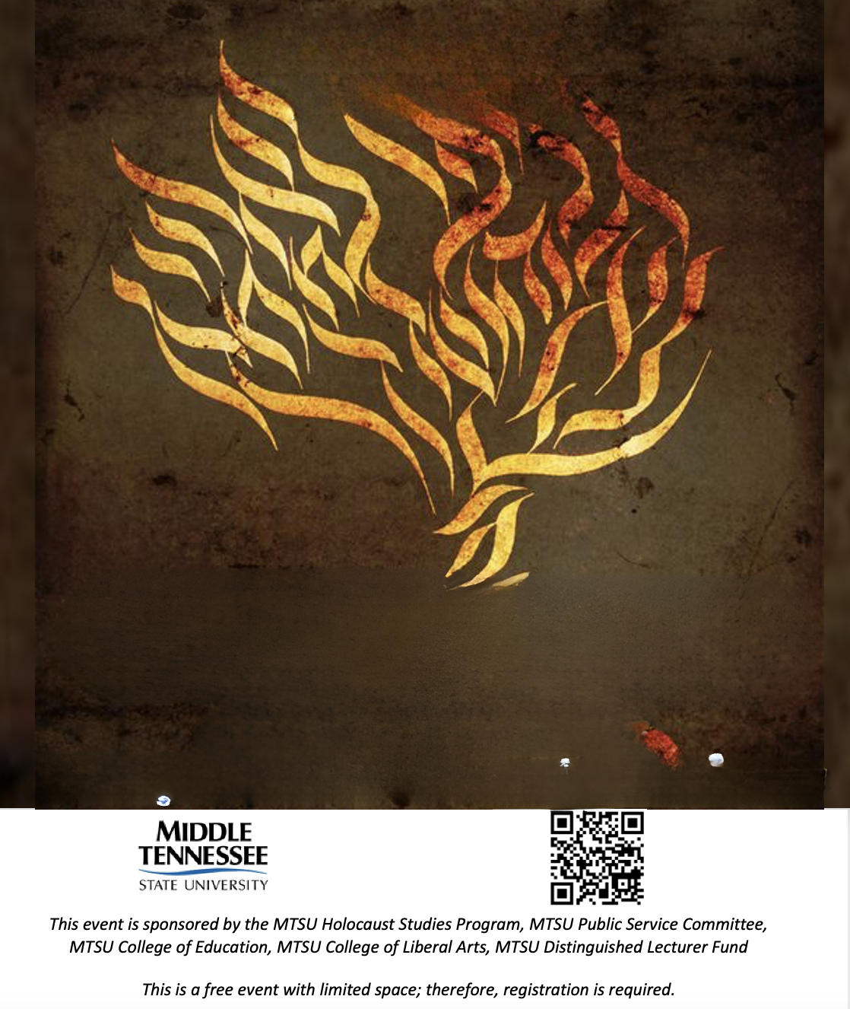


MTSU
HOLOCAUST
EDUCATION DAY
NOVEMBER 15, 2023
Lee Ramsey
Exploring the Holocaust using Literature and Music to Honor a Legacy of Strength, Endurance, & Resilience

Slide 2

If you don’t learn from history...
Why is Holocaust education important?
  Reflection
  The two most common questions every year
    “How did it happen”
    “Why did it happen to the Jews”
  “Where should we start?”

Slide 3
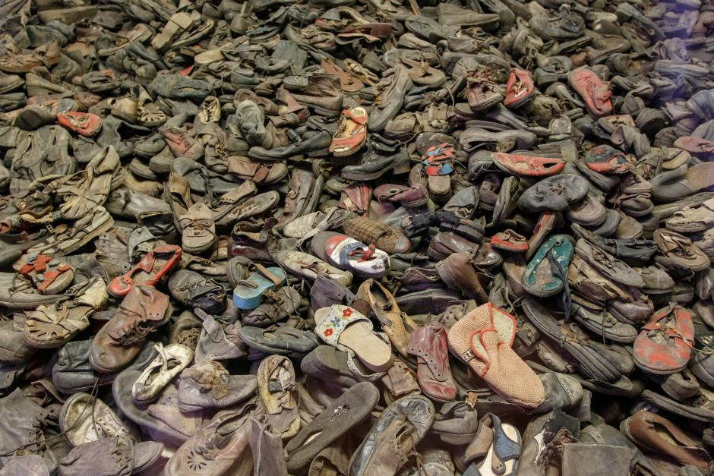
What if we start here?
What is missed?
How does this help us avoid repeating our mistakes?
Over 11 Million People...
6 Million Jews...
3 Million Soviet POW’s...
2 Million Polish...
250 Thousand Disabled...
15 Thousand Homosexuals...
Answers neither of our students’ questions.

Slide 4
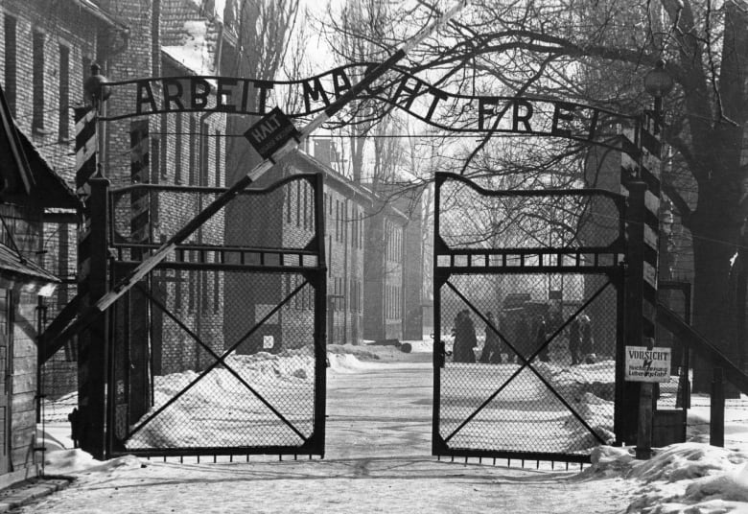
What if we start here?
What is missed?
How does this help us avoid repeating our mistakes?
Wansee Conference and the Death Camps...
Wansee Conference and the Death Camps
Wansee Conference: 1942
Auschwitz: May 20th, 1940, Sep. 1941, Jan. 1941
1.5 murdered...
Majdanek: 1941
Wansee Conference: 1942
Auschwitz: May 20th, 1940, Sep. 1941, Jan. 1941
Majdanek: 1941
Could the Nazis have started here?

Slide 5
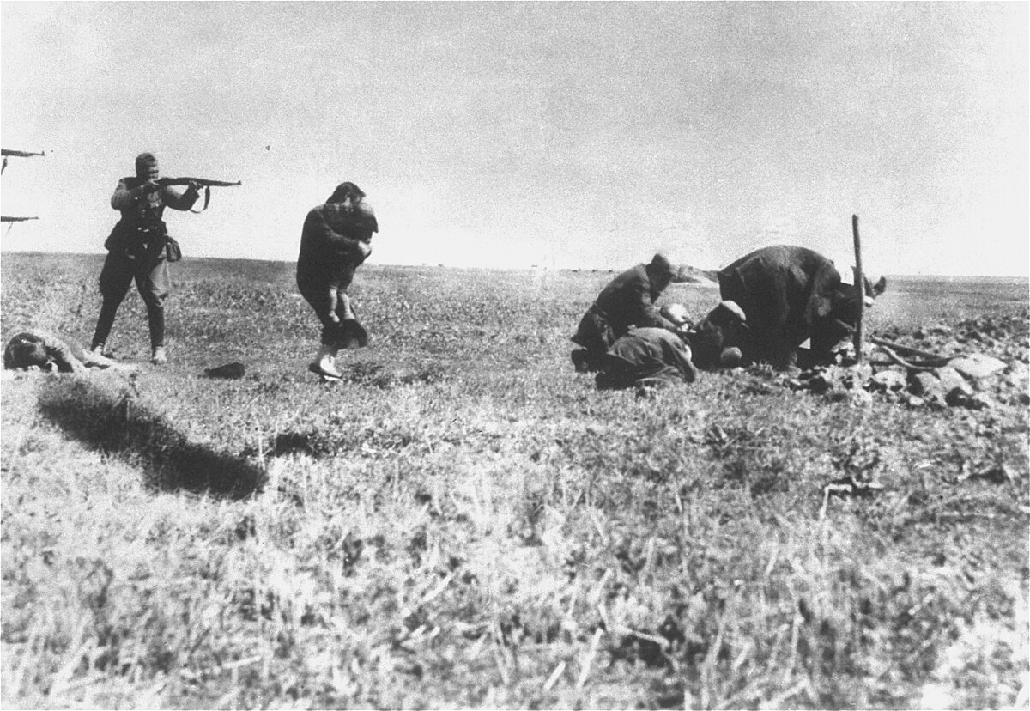
What if we start here?
What is missed?
How does this help us avoid repeating our mistakes?
Einsatzgruppen
Originally formed in 1938
Late 1939 - Aktion T4
Babi Yar - 33,771 Jews murdered in two days
Could the Nazis have started here?

Slide 6
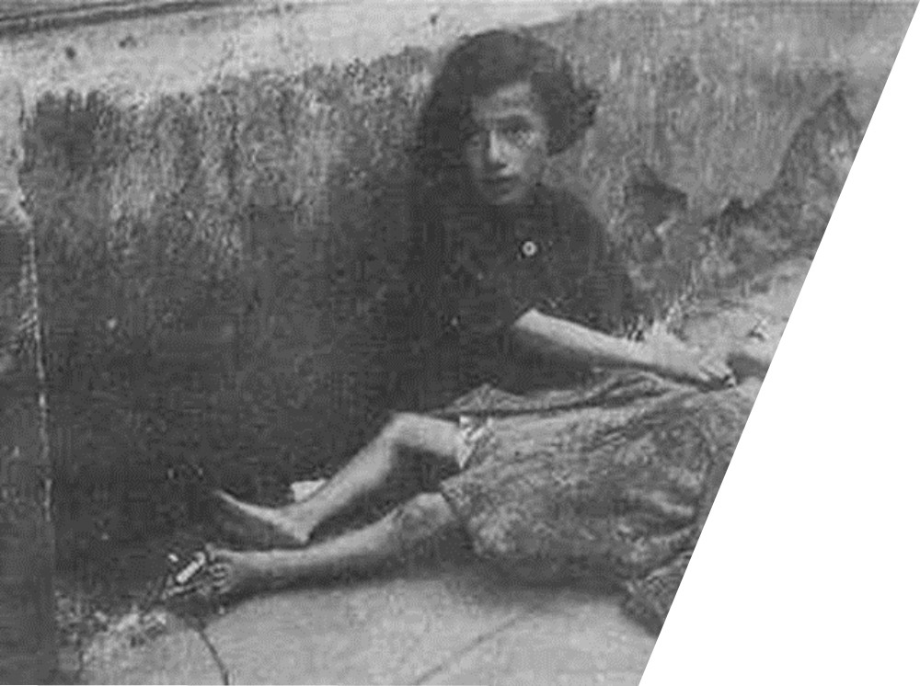
What if we start here?
What is missed?
How does this help us avoid repeating our mistakes?
Warsaw Ghetto
  October 1940
  Thousands of Jews died daily.
How did it happen?
Could the Nazis have started here?
  US Japanese Internment starts Feb 1942

Slide 7
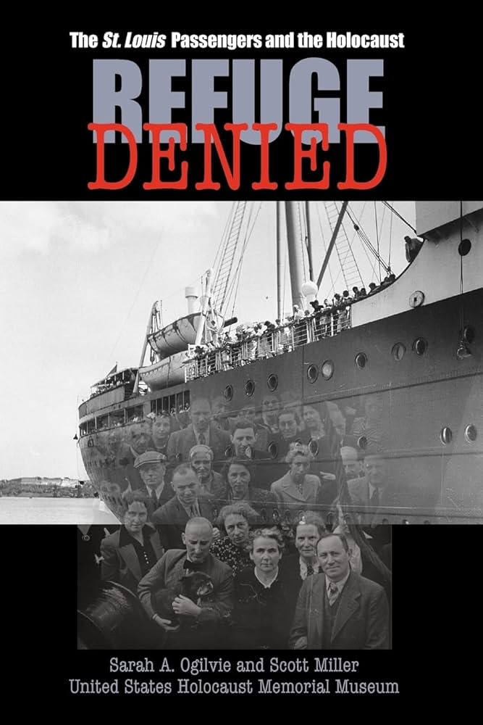
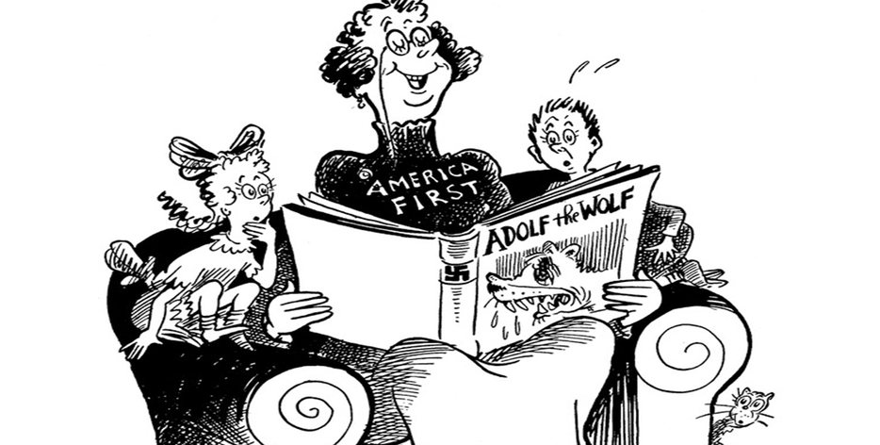
What if we start here?
What is missed?
How does this help us avoid repeating our mistakes?
  Nativism
  May 1939 - the story of The St. Louis
...and the Wolf chewed up the children and spit out their bones...But those were Foreign Children and it really didn’t matter.” 1941

Slide 8
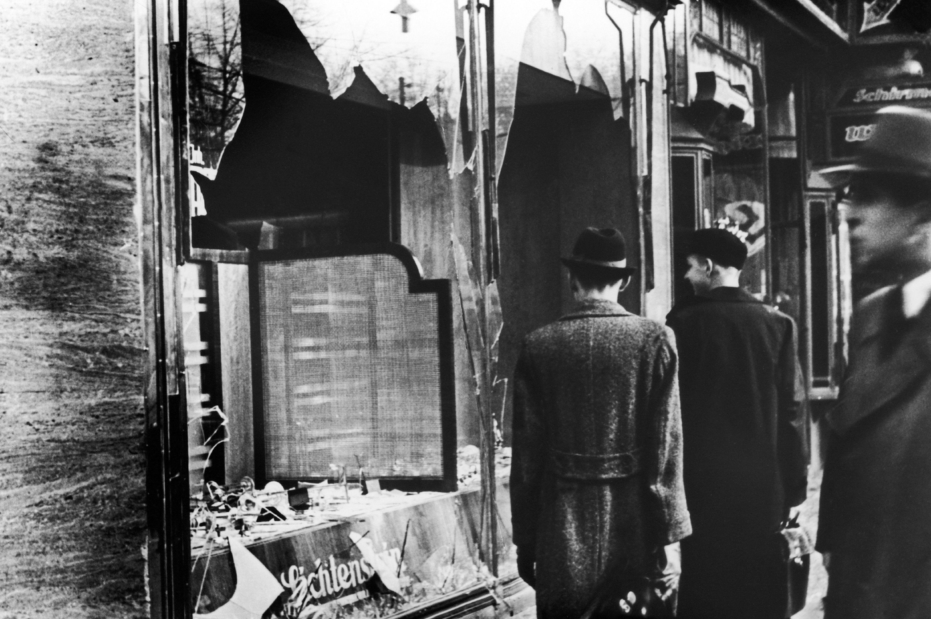

What if we start here?
What is missed?
How does this help us avoid repeating our mistakes?
KRISTALLNACHT
“The Night of Broken Glass”
November 9, 1938
  Nazis destroyed Jewish property
  Jews had to identify themselves.
  Jews were not allowed in public areas.
  Thousands of Jews were arrested.
    sent to camps
    fined for damages
How did it happen?
  Columbia TN Race Riots- 1946
Could the Nazis have started here?

Slide 9
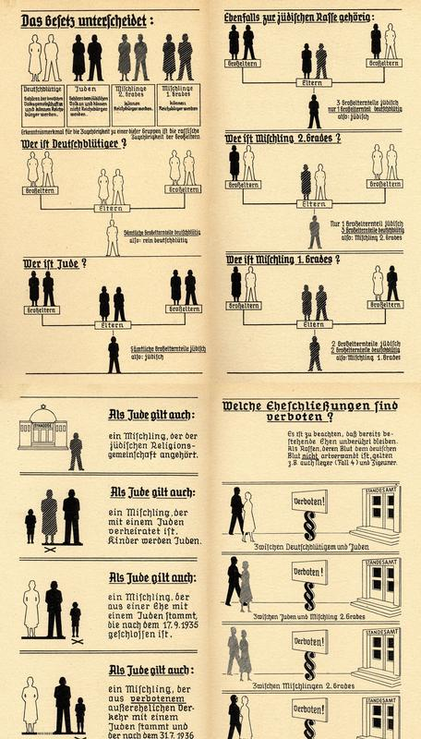


What if we start here?
What is missed?
How does this help us avoid repeating our mistakes?
Nazi Policies of persecution of Jews
  Nuremburg Laws - September 15, 1935
    Stripped Jews of German citizenship.
    Had to sell businesses to Aryan people.
How did it happen?
Could the Nazis have started here?
  1896- Plessy v Ferguson
  1936 Olympics

Slide 10
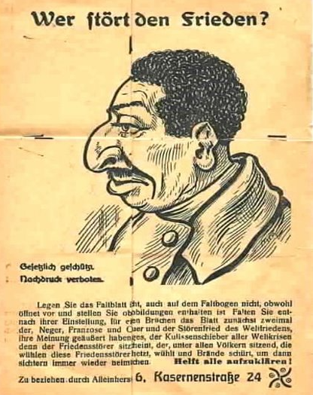





What if we start here?
What is missed?
How does this help us avoid repeating our mistakes?
Anti Semitism - Discrimination or hostility toward Jews
Religious
Economic
pre- and WWII era
Social
Racial
Social Darwinism

Slide 11

Why is Holocaust Education Important
Holocaust Education is an education in humanity...
Its worst parts are fueled by division, hatred, and cowardice, but also...
It is a study of humanity’s best qualities: endurance, legacy, and defiance.

Slide 12


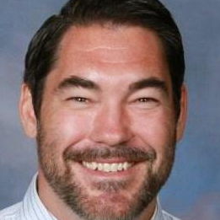
THANK
YOU
Lee Ramsey
ramseyl@rcschools.net

